Slide 1

Python vs Java: A Comparative Overview
This presentation explores the key differences between Python and Java, two popular programming languages. We'll delve into their syntax, data structures, performance, and use cases. By understanding these differences, you can make informed decisions about which language best suits your projects.
SW
by Simisola Williams

Slide 2
Introduction to Python and Java
Python
Java
Python is a high-level, interpreted language known for its readability and simplicity. It's widely used in web development, data science, and machine learning.
Java is a compiled, object-oriented language known for its platform independence and robustness. It's commonly used in enterprise applications, mobile development, and big data processing.

Slide 3
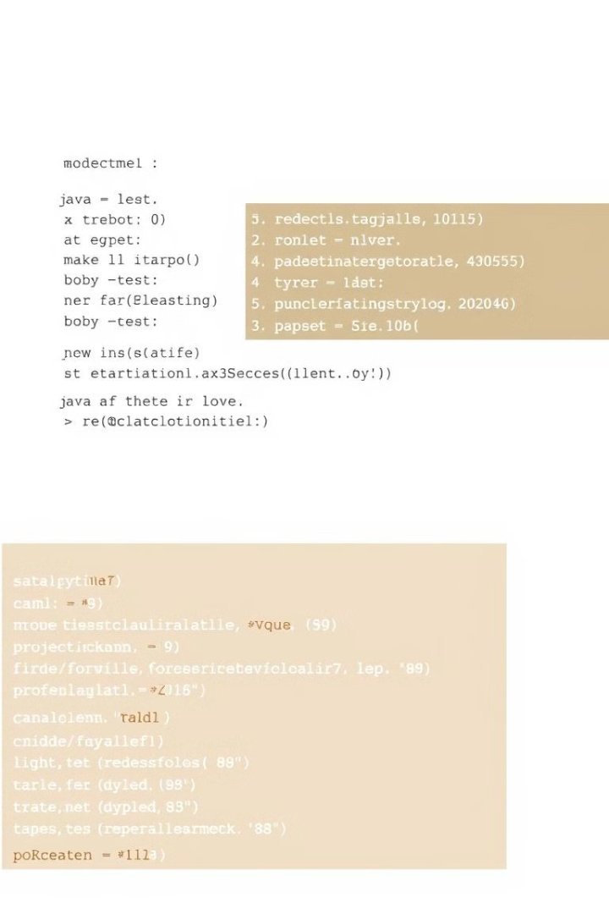
Syntax and Readability
Python
Java
Python uses a concise syntax with fewer punctuation marks and keywords, making it easier to read and write.
Java uses a more verbose syntax with more punctuation and keywords, which can lead to longer code but enhances code clarity.

Slide 4
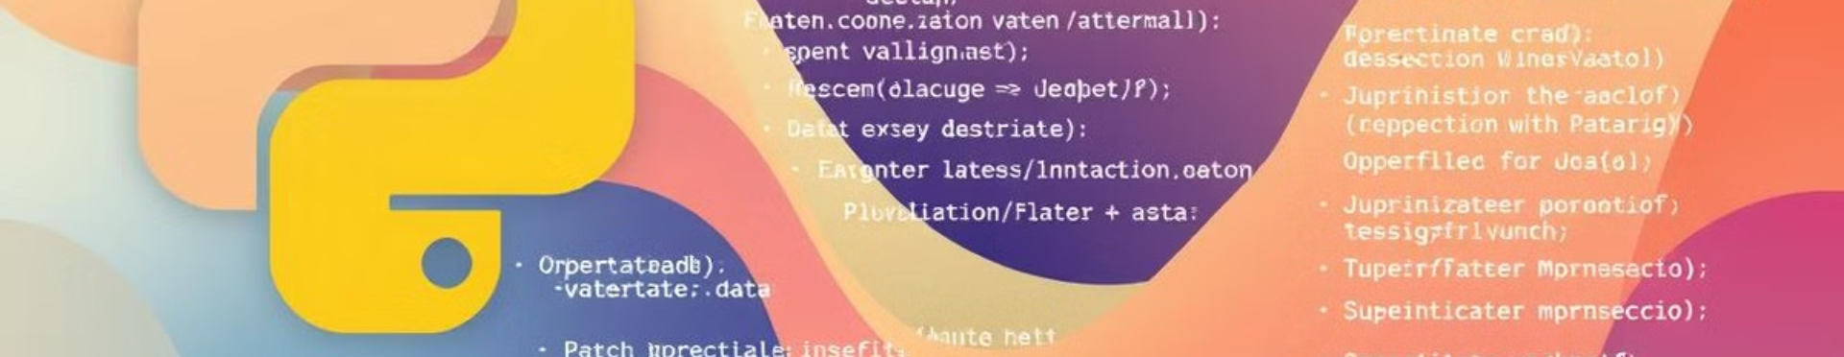
Data Types and Structures
Python
Java
Python offers dynamic typing, meaning the data type of a variable is determined at runtime. It provides built-in data structures like lists, dictionaries, and sets.
Java uses static typing, where the data type of a variable is declared explicitly. It offers primitive data types like int, float, and boolean, and data structures like arrays, lists, and maps.

Slide 5
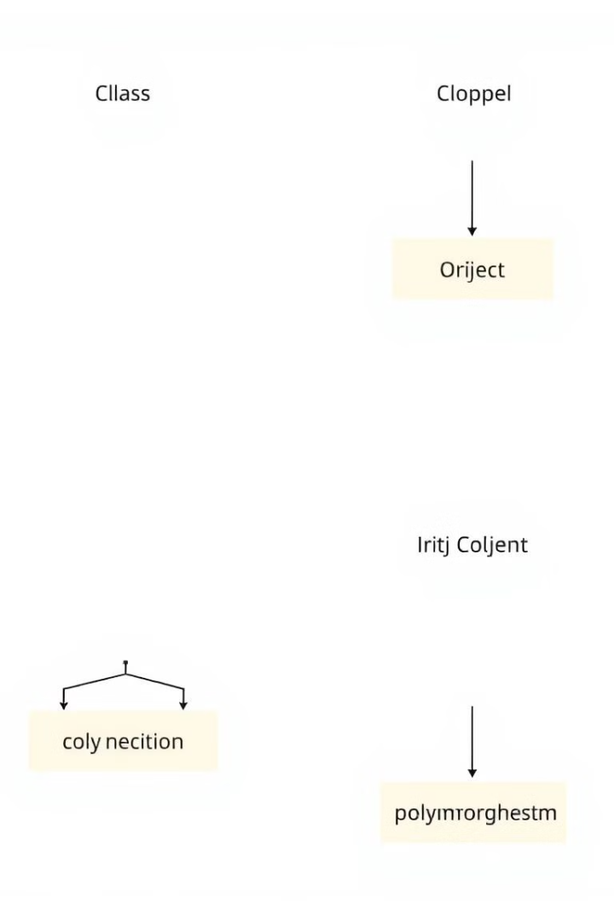


Object-Oriented Programming
Python
Java
Python fully supports object-oriented programming (OOP) principles, including classes, inheritance, and polymorphism.
Java is a pure object-oriented language, meaning everything in Java is an object. It emphasizes encapsulation, inheritance, and polymorphism.

Slide 6

Execution Environment and Performance
1
Python is interpreted, meaning code is executed line by line, making it slower than compiled languages like Java.
2
Java is compiled to bytecode, which is then executed by a virtual machine (JVM), enabling faster execution and platform independence.

Slide 7



Web Development and Frameworks
Python
Python frameworks like Django and Flask provide robust tools for building web applications, including routing, templating, and database integration.
Java
Java frameworks like Spring Boot and Struts offer comprehensive solutions for enterprise web development, supporting complex functionalities like RESTful APIs and web services.

Slide 8

Data Science and Machine Learning
Python
Python is the dominant language in data science due to its rich libraries like NumPy, Pandas, and Scikit-learn, making it suitable for data manipulation, visualization, and machine learning tasks.
1

Slide 9
Enterprise Application Development
Java
1
Java is preferred for enterprise application development due to its robustness, scalability, and support for multithreading and distributed systems.

Slide 10
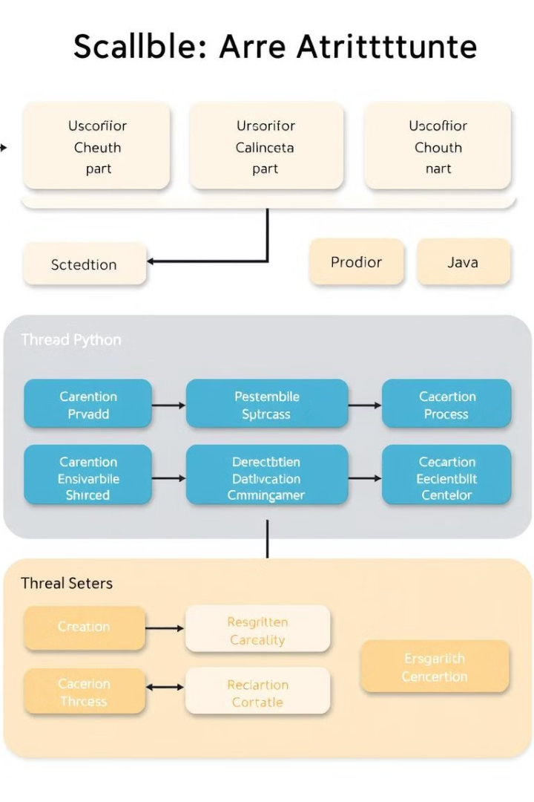
Scalability and Concurrency
1
2
Python
Java
Python's Global Interpreter Lock (GIL) can limit concurrency, making it less ideal for highly scalable, multi-threaded applications.
Java's JVM effectively handles concurrency, enabling efficient multithreading and supporting high-performance, scalable applications.

